Slide 1
Upflow Anaerobic Sludge Blanket (UASB)
Mary McGuinn

Slide 2

AguaClara Cornell
Uphold and protect the fundamental human right to access safe drinking water.
Students lead the innovation process, learn from each other, and foster a collaborative environment.
Develop sustainable alternatives to current technologies.
Research. Invent. Design. Engage.

Slide 3

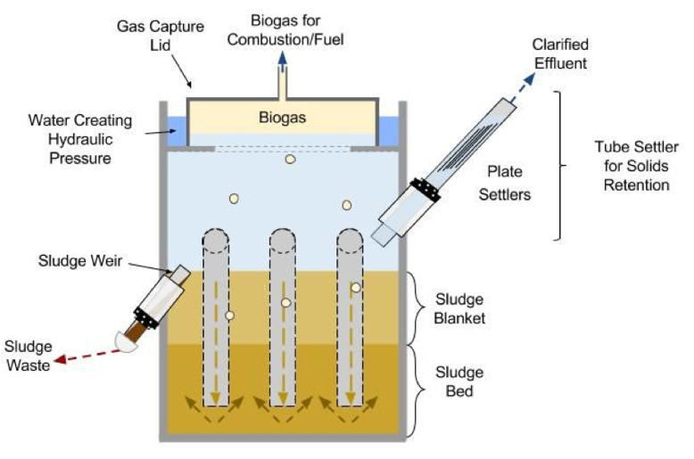

UASB
z
Locally constructed, easily accessible materials
Operates without electric

Slide 4
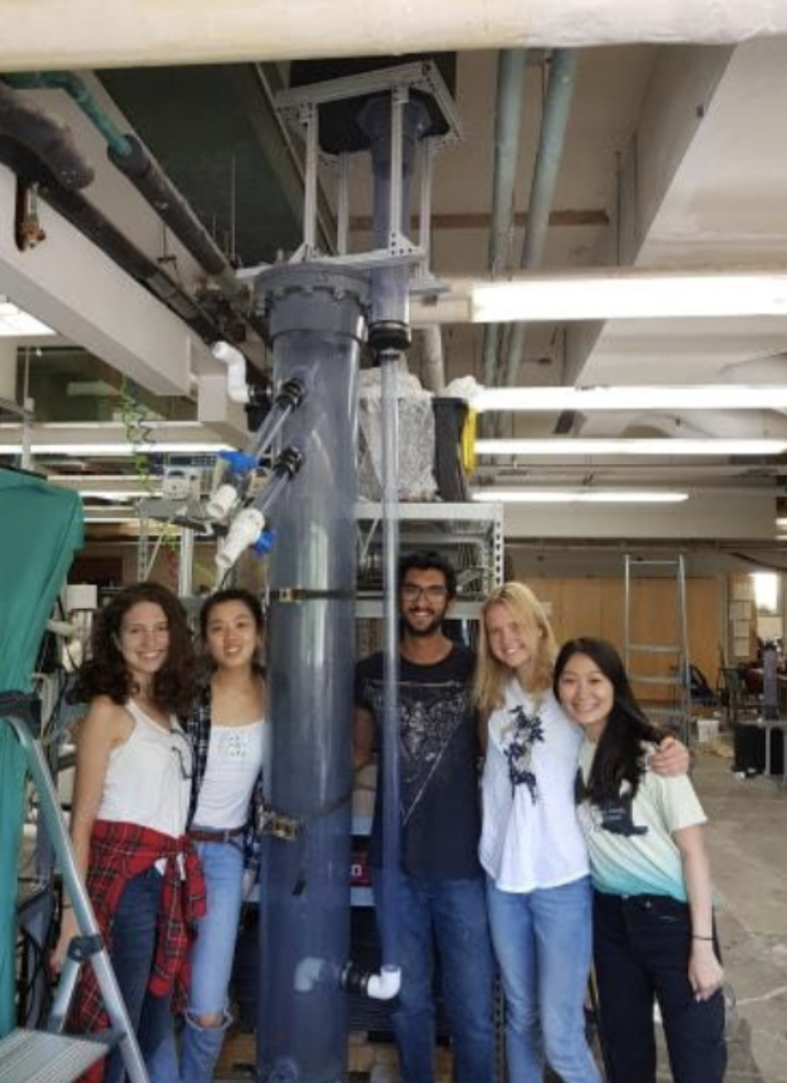
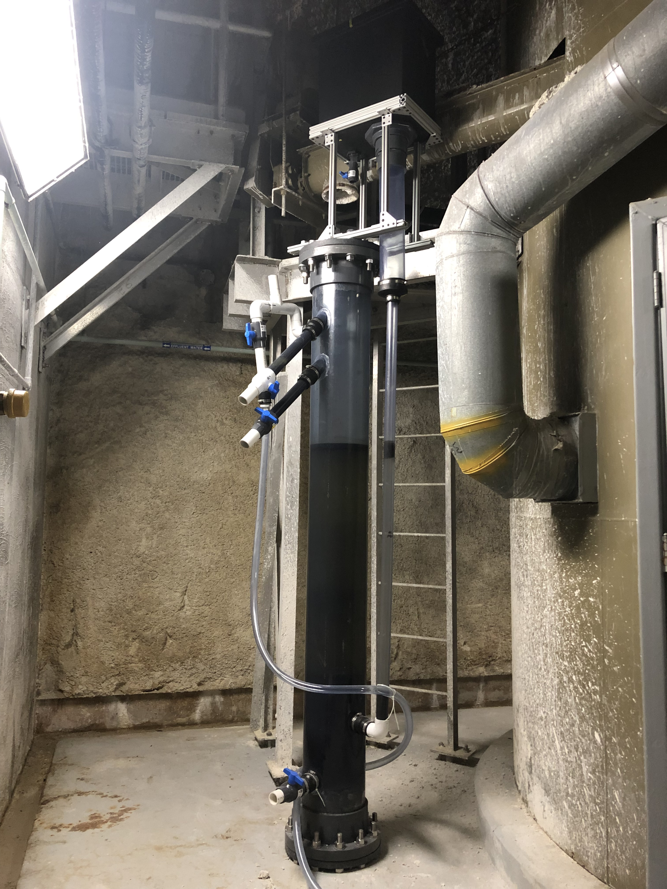
Pilot Study
Wastewater treatment plant in Ithaca, NY
3 Person home of waste water
Produces a maximum of 60 L/day biogas
(~ 20 minutes of cooking time)

Slide 5
Advantages
Electric-free
Low space requirement
Biogas production (fuel, lighting)
Low sludge production
High efficiency
No mixing required

Slide 6
Responsibilities
Sanitation for pathogens and nutrients
Chance of repairs
Collection and distribution of biogas

Slide 7
Post-treatment Options
z

Slide 8
Post-treatment
Important to improve the quality of water
May be needed to reach quality standards
Eliminates more organic matter, nutrients, and pathogens than the UASB system can alone

Slide 9
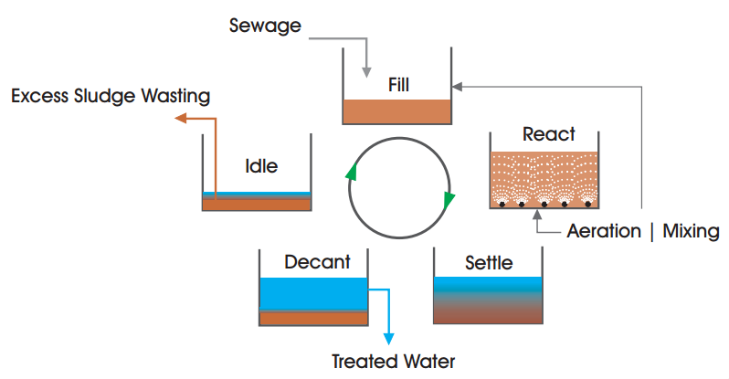
CONSTRUCTED WETLAND
+ Simple construction and maintenance, good for rural communities
- High land requirement, limited nutrient and pathogen removal
SEQUENCING-BATCH REACTOR
+ High efficiency and operational flexibility, nutrient removal
- Difficult start-up, need treatment and disposal of sludge
ACTIVATED SLUDGE
+ High efficiency: operational flexibility, BOD removal, nutrification
- High construction and operational costs

Slide 10
DISSOLVED-AIR FLOTATION
+ High loading rates, excellent removal of Crytosporidium and Giardia
- Need coagulant/flocculant, poor removal of ammonium and fecal coliforms
DOWNFLOW-HANGING SPONGE
+ Low cost, easy maintenance, simultaneous nitrification/denitrification
- Low durability of packing material, further study needed
ROTATING-BIOLOGICAL CONTACTOR
+ No recirculation required, low maintenance, good E-coli removal
- High HRT required for low temperature, needs frequent maintenance

Slide 11
Option: Trickling Filter
Flexible for our system
High efficiency
Low operational cost and land requirements
Cons: need packing media, need another method for ammonia removal and sludge treatment, and high construction costs

Slide 12
Option: Stabilizing Pond
Simple and low maintenance
No energy requirement
High COD/BOD removal regardless of climate and SS production
Cons: requires land and high SS concentration

Slide 13
Biogas
z

Slide 14
About
Reliable and cheap energy feedstock
Healthier
Environmental impacts
Notes:
Resp. issues arise with use of biomass (eg firewood)

Slide 15
Advantages
Instant heat upon ignition (no pre-heating)
Burns cleanly
Releases less greenhouse gases
Slurry provides fertilizer
Heat can be controled

Slide 16
Adaptations
Change appliances (cost)
Change cooking habits

Slide 17
Use
Collect
Collect biogas from system in a durable inflatable container
Check
Check your appliance is biogas-friendly or modify a current appliance
Using current appliances results in low-performance
Use
Use with approved appliance
Cooking
Electricity
Refrigeration

Slide 18
Biogas Compatible Devices Cooking
z
Gas Cooker/Stove Specific for Biogas
Simple and easy
Versatile in terms of pot type and size
Easy to clean and repair
Moderate cost
Modified Commercial Burner
This will result in low-performance
Expand the injector cross-section 2-4x
Increase size of jets (if needed)
Biogas pressure is between 75 to 150 mm of water column
Goal: achieve a stable, compact, bluish flame
Notes:
Consumption rate: 150-400 L/hr for a biogas stove

Slide 19
Modified Gas Stove
About
Need to modify because butane/propane is approximately 3x more powerful to burn than biogas
Experimental matter
Preferred modified stove burner – Lotus
How to
Expand injector cross section by 2-4x
Increase size of jet openings (if possible)
Can be done with electric drill
Lotus burner

Slide 20
Other
z

Slide 21
Collective System
Combine 2+ systems to provide for more people
Advantages:
Increased biogas production rate
Responsibilities are shared

Slide 22
Savings Propane –> Biogas
25.70 lempira per liter
Propane: 1 liter/hr of cook time
Biogas: 150 liter/hr of cook time
1 day of biogas production from 1 UASB unit saves
~ 11.0 Lempira
1 year of biogas production from 1 UASB unit saves
~ 4015.0 Lempira
* Estimates from Tegucigalpa prices,
Notes:
Update: Honduras gasoline prices, 04-Nov-2019 | GlobalPetrolPrices.com. (n.d.). Retrieved November 5, 2019, from https://www.globalpetrolprices.com/Honduras/gasoline_prices/
1 kg firewood ~= 200 L biogas https://akvopedia.org/wiki/Biogas_Combustion
20 lb tank ~= 20.5 hr cook time ~= 18 L
=> 17.8 L/20.5 hr cooking ~= 1 L/hr

Slide 23
Biogas Results
Household Burner | Refrigerator (100 L) | Gas Lamp (60 W bulb)
60 L of biogas ⟹ 20 min of cooking time | 60 L of biogas ⟹ 120 min or 2 hr of cooling time (depends on outside temperature) | 60 L of biogas ⟹ 30 min of light

Slide 24
Questions?
z

Slide 25
References
(n.d.). Retrieved from http://alianzaporelagua.org/Compendio/tecnologias/t/t9.html.
Burning Blue Flames Gas Focus on Stock Photo (Shutterstock) 1499930861. (n.d.). Retrieved December 10, 2019, from https://www.shutterstock.com/image-photo/burning-blue-flames-gas-focus-on-1499930861
Biogas Appliances - energypedia.info. (n.d.). Retrieved November 5, 2019, from https://energypedia.info/wiki/Biogas_Appliances
Chong, S., Sen, T. K., Kayaalp, A., & Ang, H. M. (2012). The performance enhancements of upflow anaerobic sludge blanket (UASB) reactors for domestic sludge treatment – A State-of-the-art review. Water Research, 46(11), 3434–3470. https://doi.org/10.1016/J.WATRES.2012.03.066

